Slide 1
Exploratory data analysis on World population session 2022-23
Submitted By: Shubham Sharma
Guided By: Mario Thokchom

Slide 2
Introduction
The current US Census Bureau world population estimate in June 2019 shows that the current global population is 7,577,130,400 people on earth, which far exceeds the world population of 7.2 billion in 2015.
Our own estimate based on UN data shows the world's population surpassing 7.7 billion.
The global population will reach 8 billion on November 15, 2022, more than three times the population of 2.5 billion in 1950.
By the year 2030, the country of India is expected to become the most populous country in the world.
This is because India’s population will grow, while China is projected to see a loss in population.

Slide 3
Goals
The primary aim of our project is to collect and analyze the data of world population. In the project we analyze various factors of world population.
Total number of countries in each continent
Population Growth
Top populated countries
Populations growth of countries
Most land available countries
Lowest land available countries
Land available per person

Slide 4
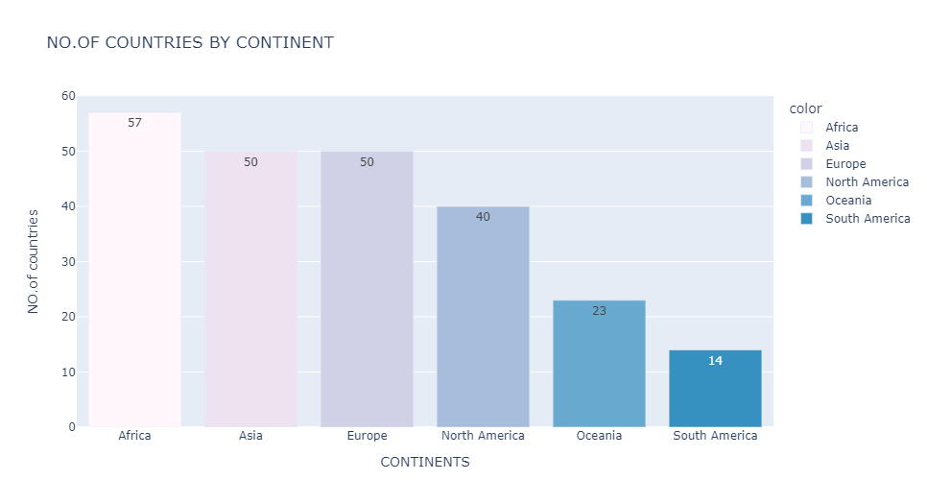
Countries in each continent
There are 6 continents and 234 countries in the world. Each continent has different no. of countries. Africa has most no. of countries in the world with 57.

Slide 5
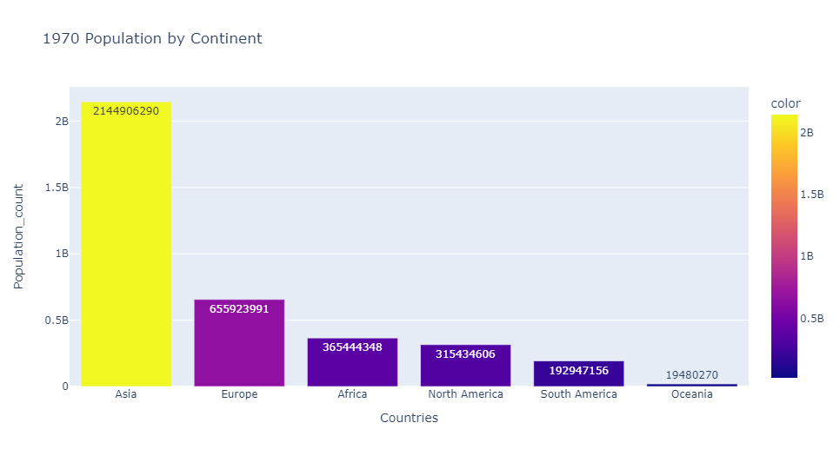
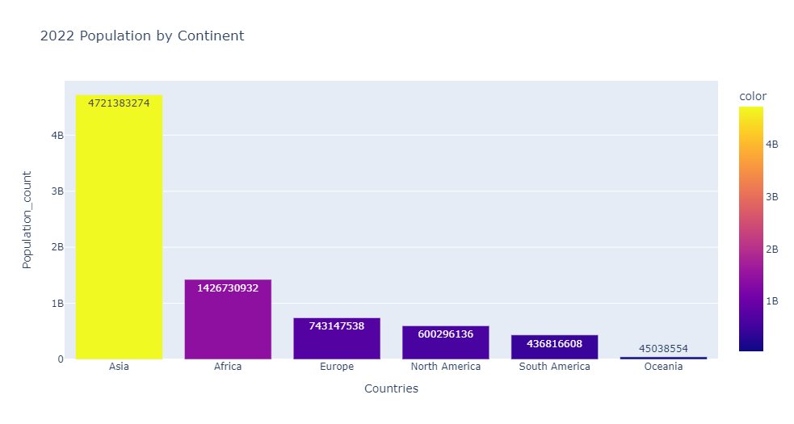
Population of Continents(1970-2022)
Asia is the most populated continent in the world. Asia dominating from the 1970 and still dominates the list. It covered more than 50% of world population.

Slide 6
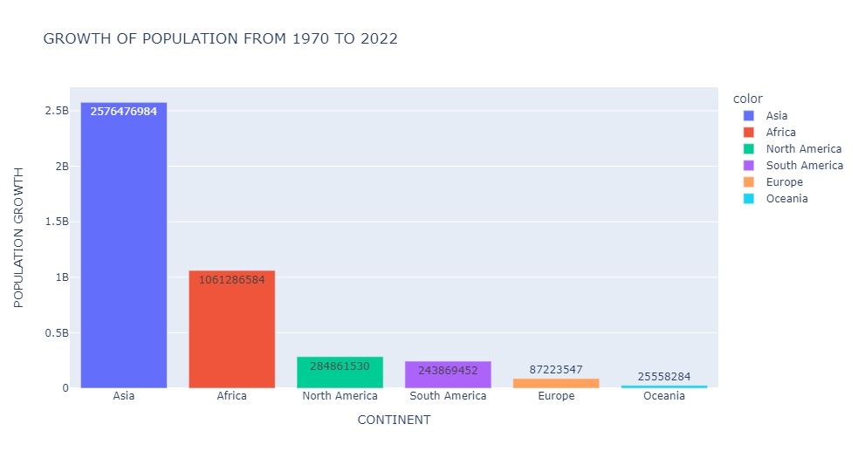
Population Growth of Continents
If we consider growth rate Asia again top the chart with highest growth rate with 2.57B population. While Oceania has lowest growth rate 0.25 B.

Slide 7
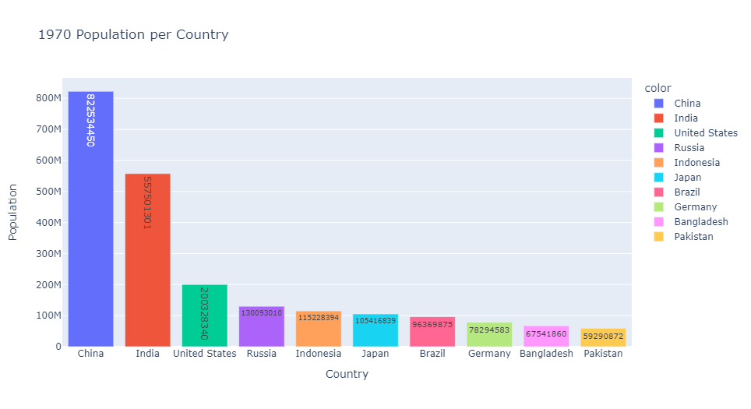
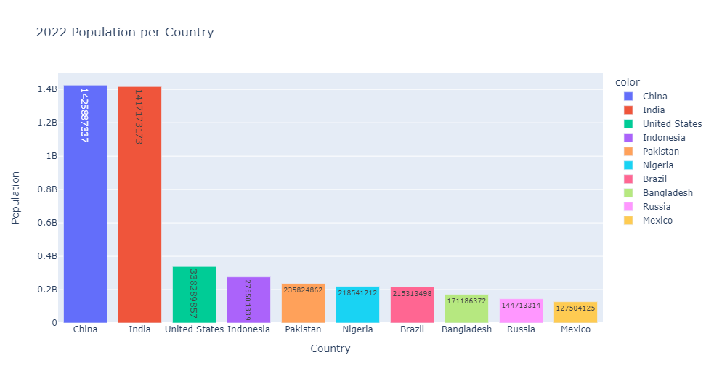
Top Populated countries (1970-2022)-
China is the country with highest population of 1.42B in the world & India is the second country with population of 1.41B.

Slide 8
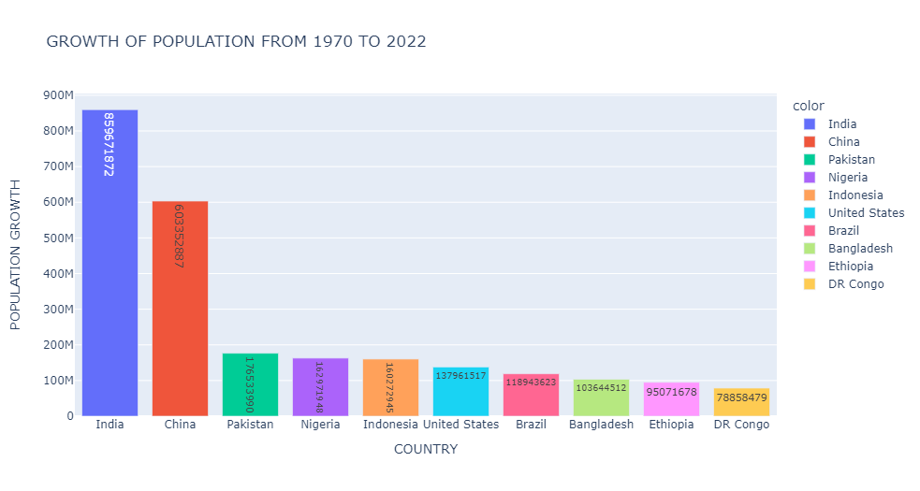
Population Growth of countries
we can see that India is the country with highest population growth of 859.67M in the world

Slide 9
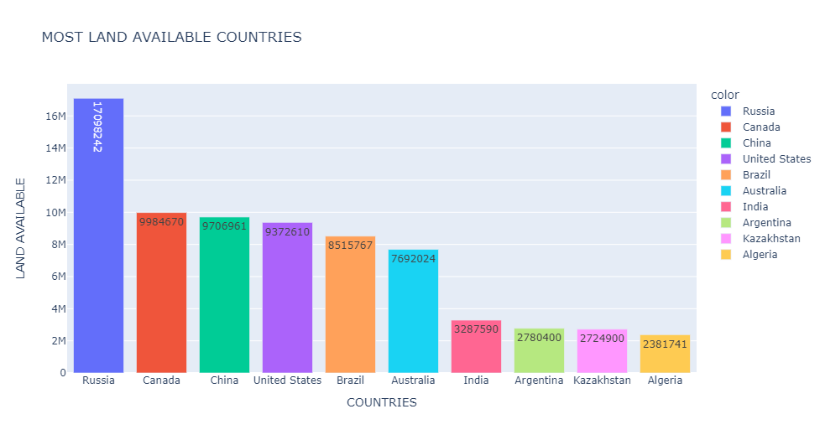
Most land available per country
The largest country in the world is Russia with a land area of 17,098,242 Km², equivalent to 11% of the total world's landmass

Slide 10
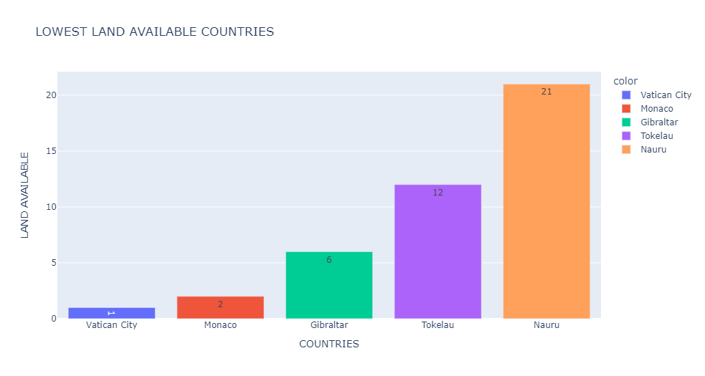
Lowest land available per country
Vatican City tops the graph with lowest area approx 1 km². Other countries are Monaco, Gibraltar Tokelau and Nauru etc.

Slide 11
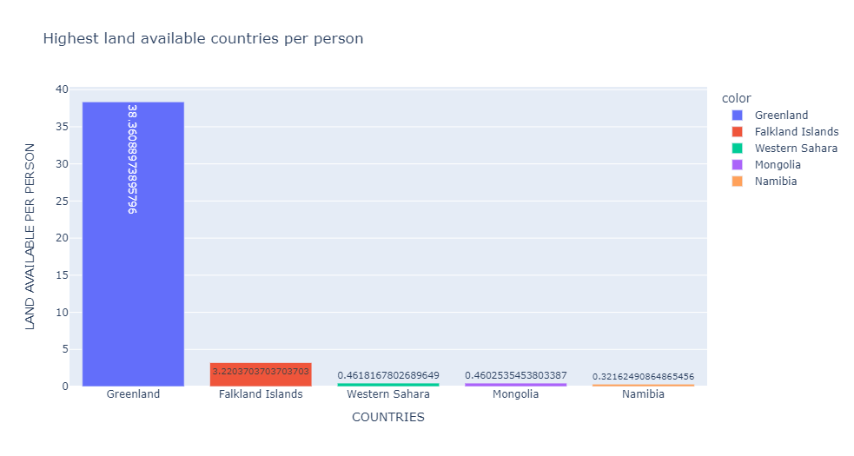
Highest land available countries per person
we can say that Greenland has most land per person in countries with 38.36 Km², Which is very high compare to other countries. Falkland Islands second in the list with 3.22 Km² land area.

Slide 12
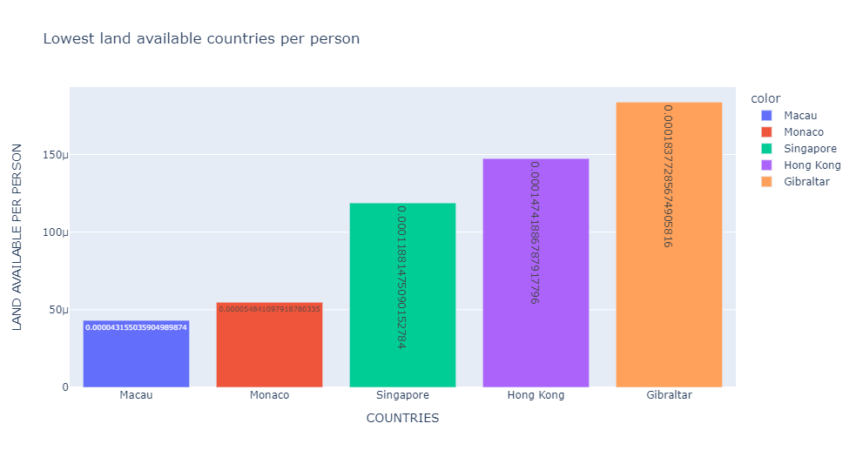
Lowest land available countries per person
Macau is the country with lowest land availability. other countries are Monaco, Singapore, Hong-Cong and Gibraltar etc.

Slide 13
Insights
Africa has highest no. of countries 57 among all
Asia and Europe have tied with 50 countries each
South America has l0west no. of countries with 14
Asia has highest population among all the continents
The Population growth of Asia (1970 to 2022) is from 2.144 B to 4.721 B with difference of 2.577 B.
China is the country with highest population of 1.42B in the world & India is the second country with population of 1.41B.
India is the country with highest population growth of 859.67M in the world

Slide 14
Continue…
Russia tops the most land available per country 17.09M
India ranks 7th in top land available countries with 3.29M
Vatican City has lowest land in the world 1 km²
Greenland tops the chart with 38.36 km² per person for a country.
Macau has lowest area per person with 0.000043 km² per person.

Slide 15
Conclusion
The world's population is growing year by year (no sign of decreasing). According to current population growth estimates, the Earth will be overpopulated by 2050 or earlier.
From the analysis we can conclude that Asia is most populated continent and china is most populated country in the world.
India rank 2nd in the most populated country in the world.
In 1970 difference between Population of China and India was large but now in 2022 difference is very small.

Slide 16
Continue
Russia is most land available country in the world, It covered approx 11% of total land area while India ranked 7th in the world.
Vatican City has lowest land area approx 1 Km².
If we talk about the area per person in a country Greenland tops the chart, it has almost 38 Km² land area per person while lowest area for a person in a country, Macau has least area per person.

Slide 17
Thank You

